Slide 1
CENG-232 Logic Design
Week 5
Encoders, Binary addition, Examples

Slide 2
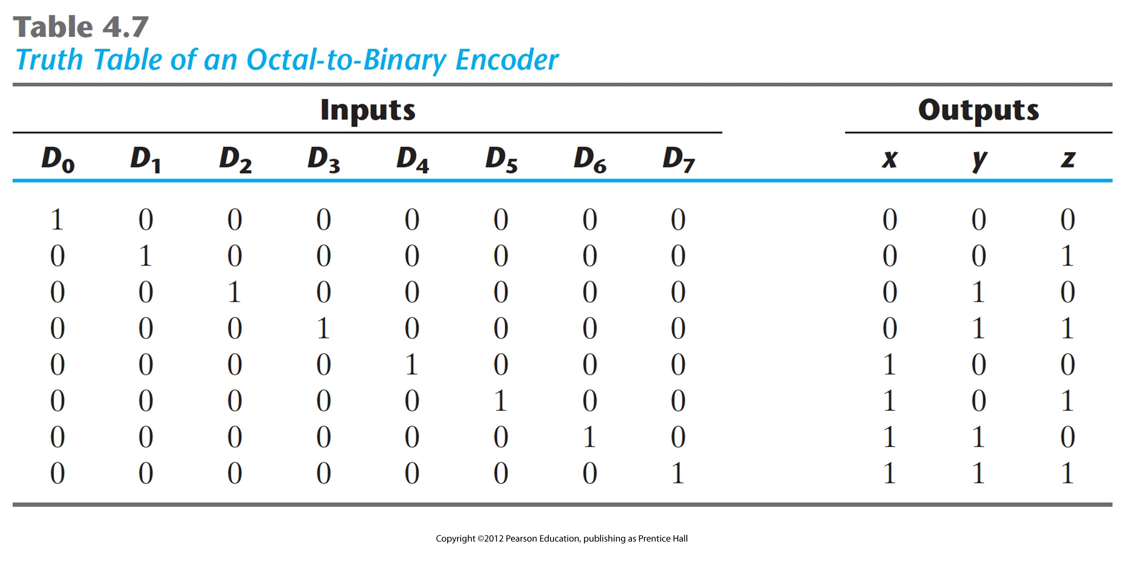
Encoders
A digital circuit that performs the inverse operation of a decoder.
Has 2^{n} (or less) input lines and n output lines.
The output lines, as a group, generate the binary code corresponding to the input value.
An example: octal-to-binary encoder
Note that the input space is huge! Think about how would you implement this truth table. Read Sec 4.10 in your book.

Slide 3
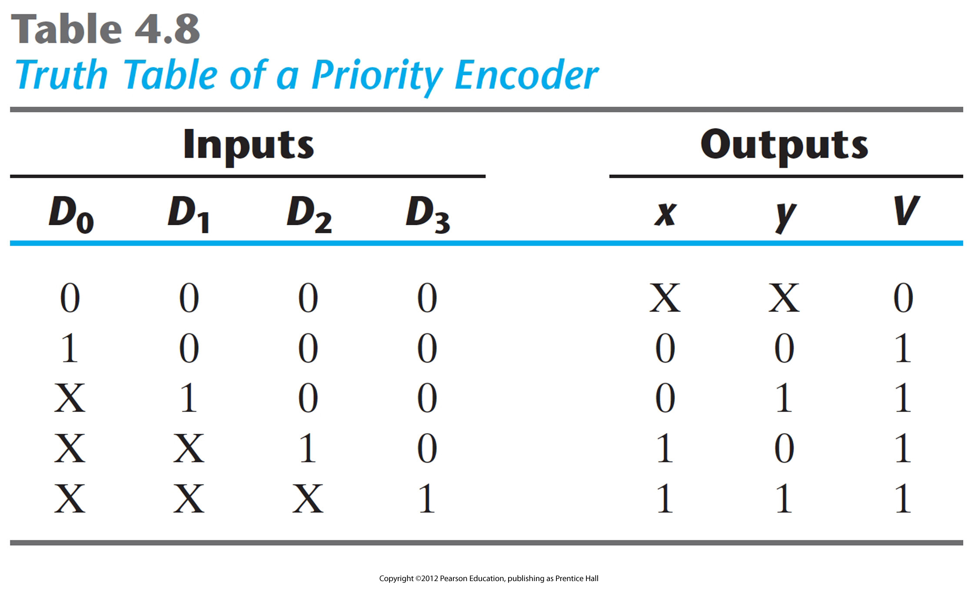
Another example: priority encoder
Priority encoding: if two or more inputs are 1 at the same time, the input with highest priority will take precedence. (try to write the truth table!)

Slide 4
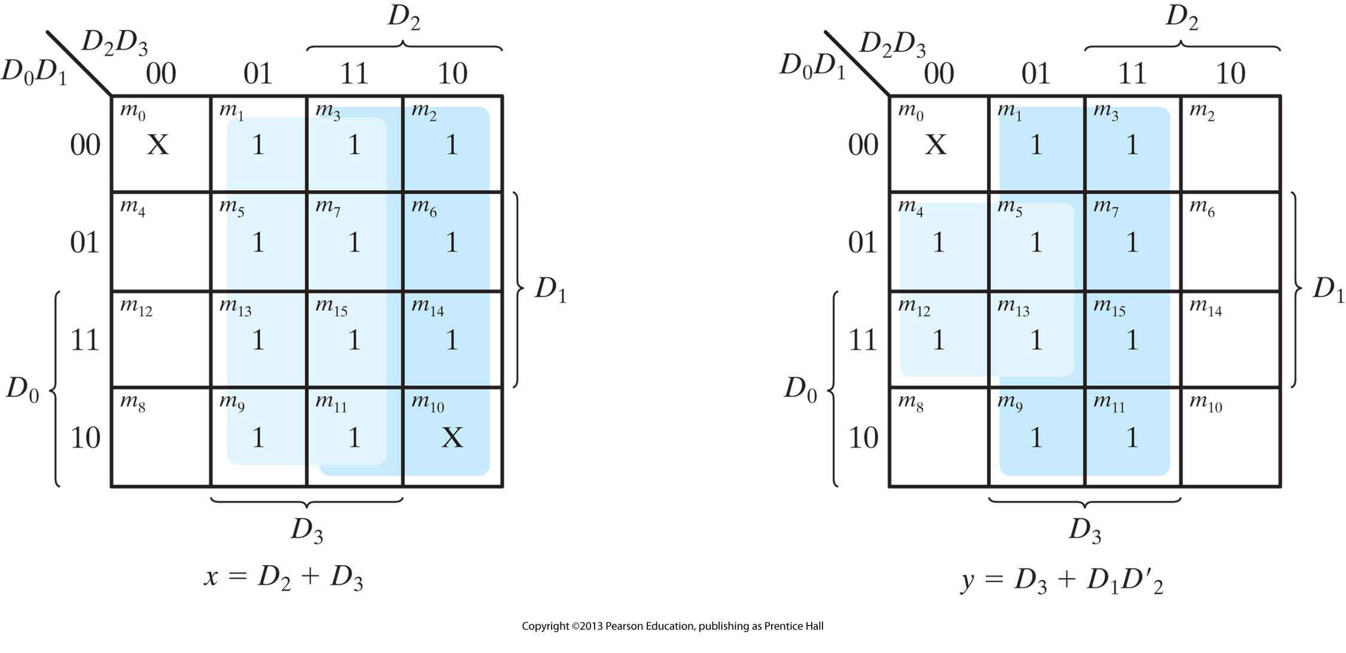
Priority encoder
Write K-maps for outputs x and y, also V (valid bit)

Slide 5
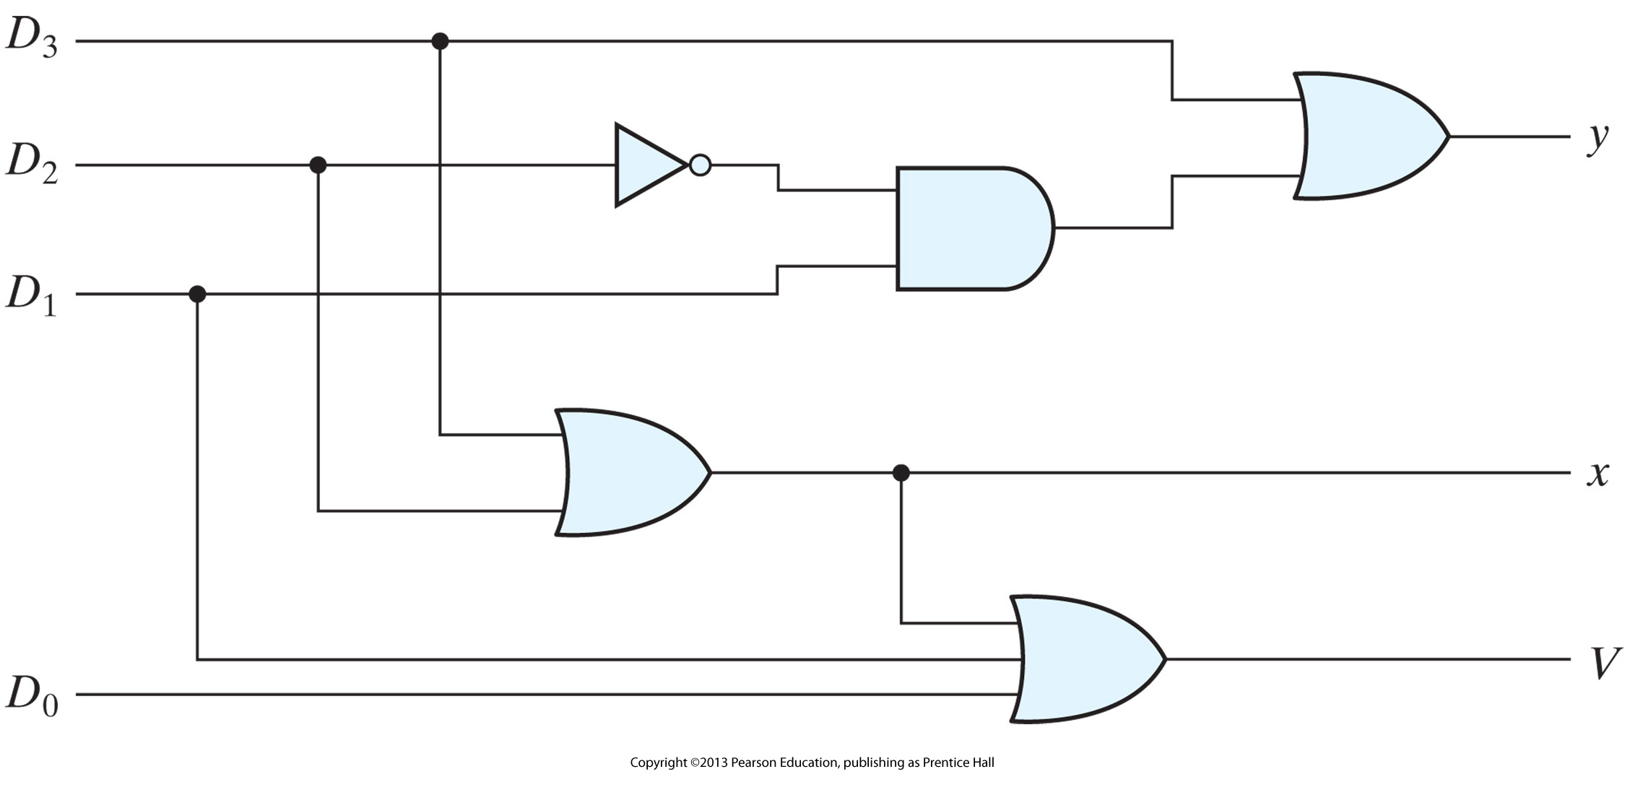
Priority encoder
Draw the circuit from the expressions

Slide 6
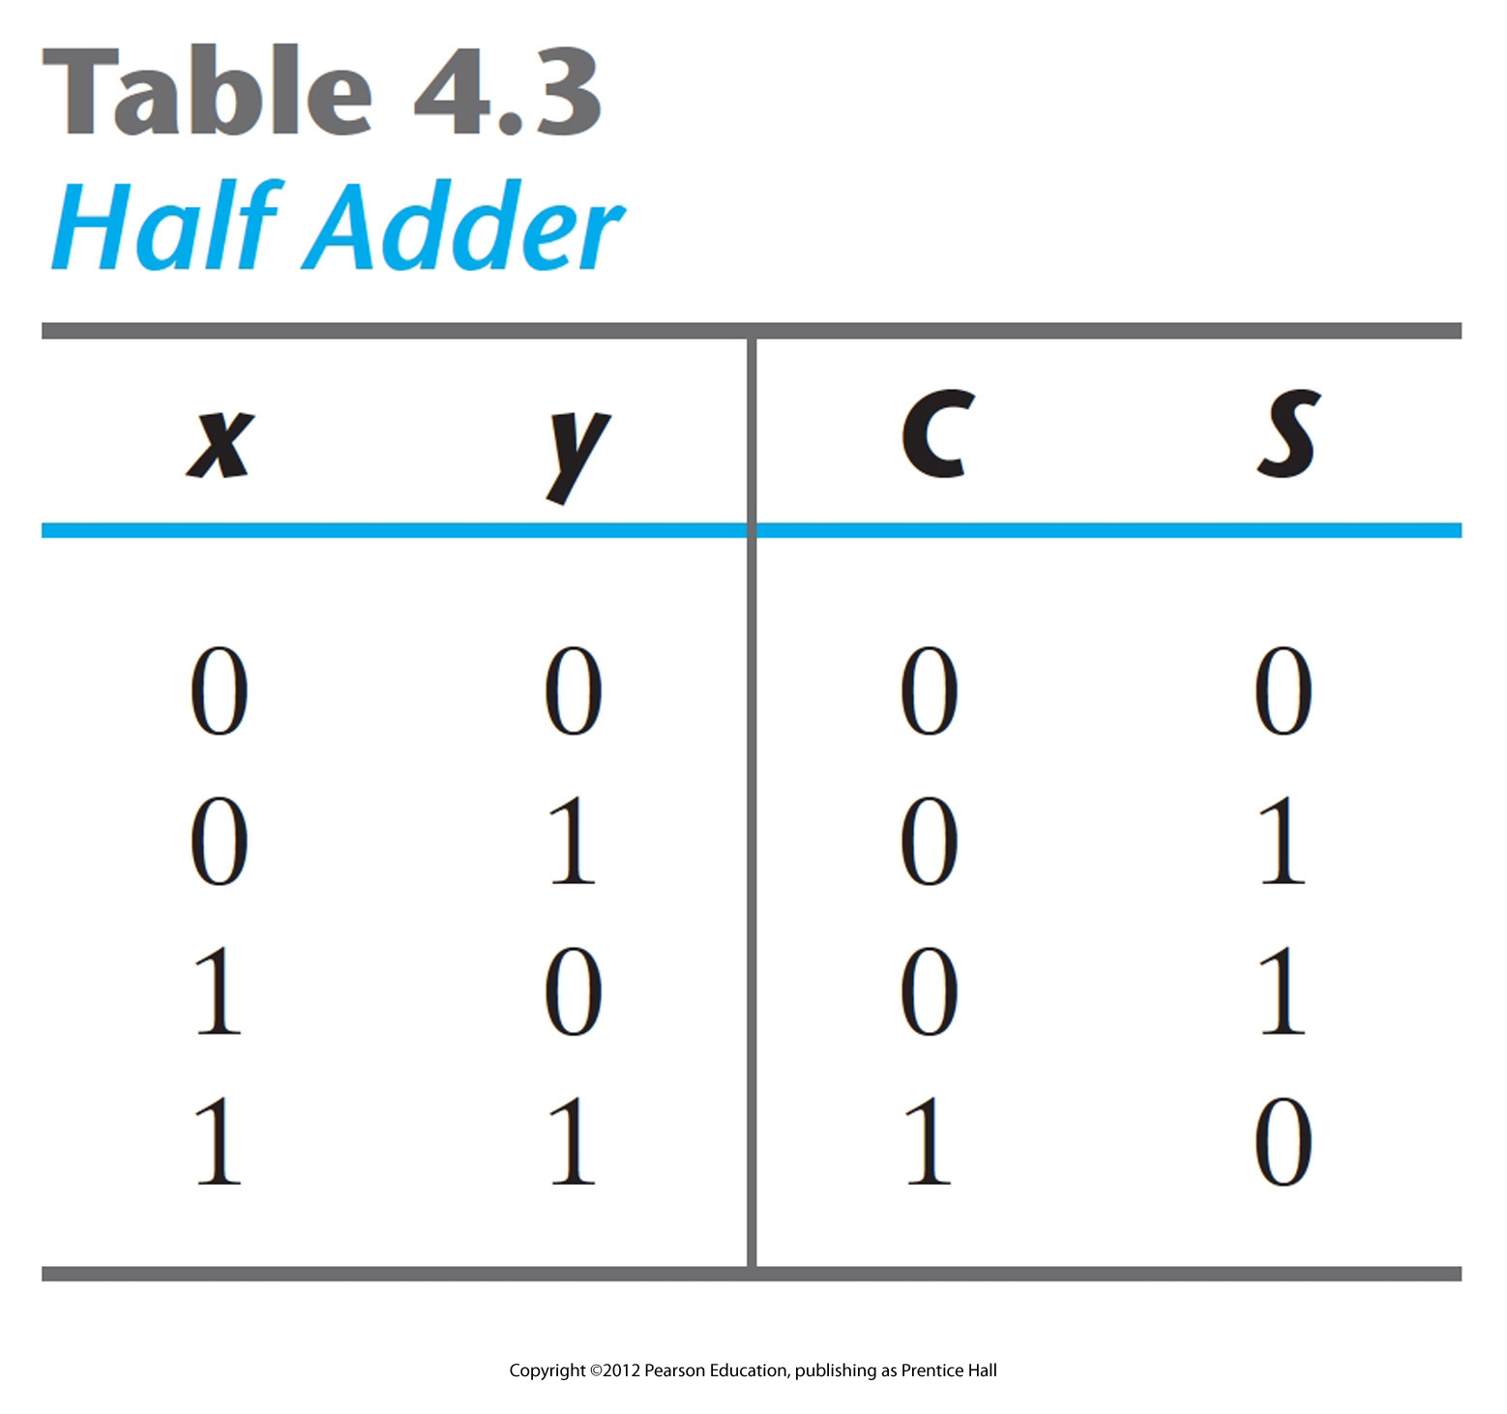
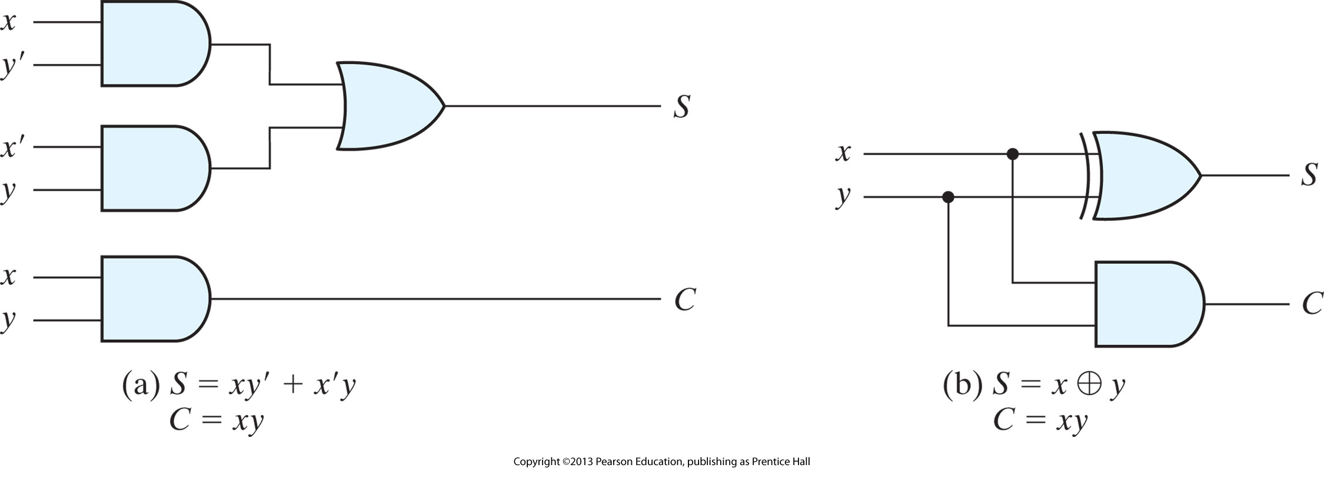
Binary addition
Half adder: performs the addition of two bits.

Slide 7
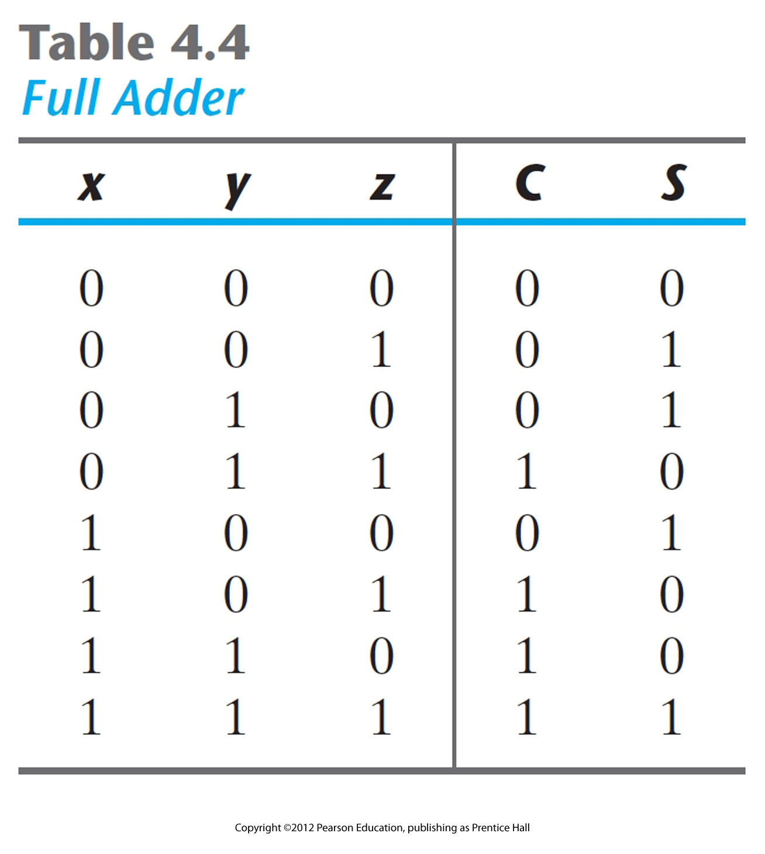
Full adder
Performs the addition of three bits (two bits and a previous carry)

Slide 8
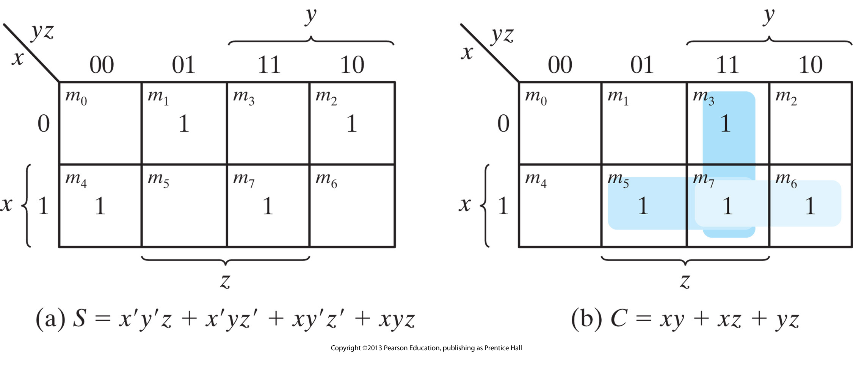
Full adder
Performs the addition of three bits (two bits and a previous carry)

Slide 9
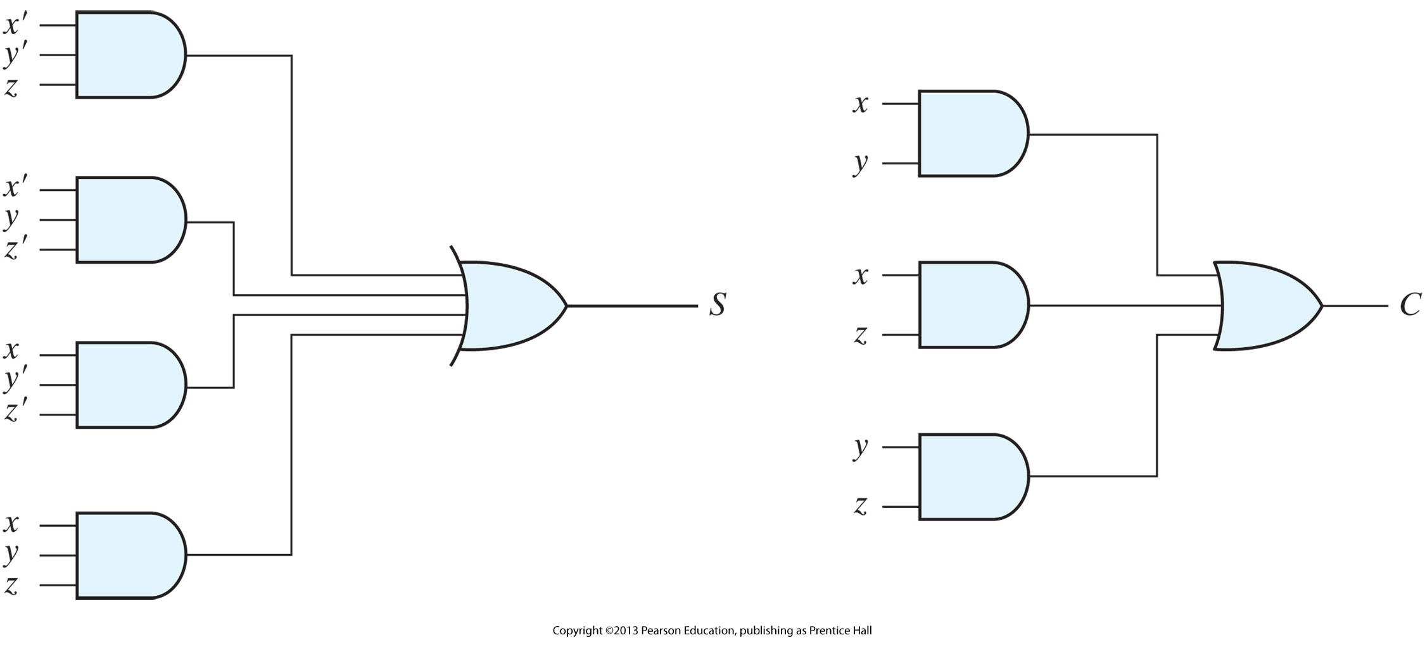
Full adder
Performs the addition of three bits (two bits and a previous carry)

Slide 10
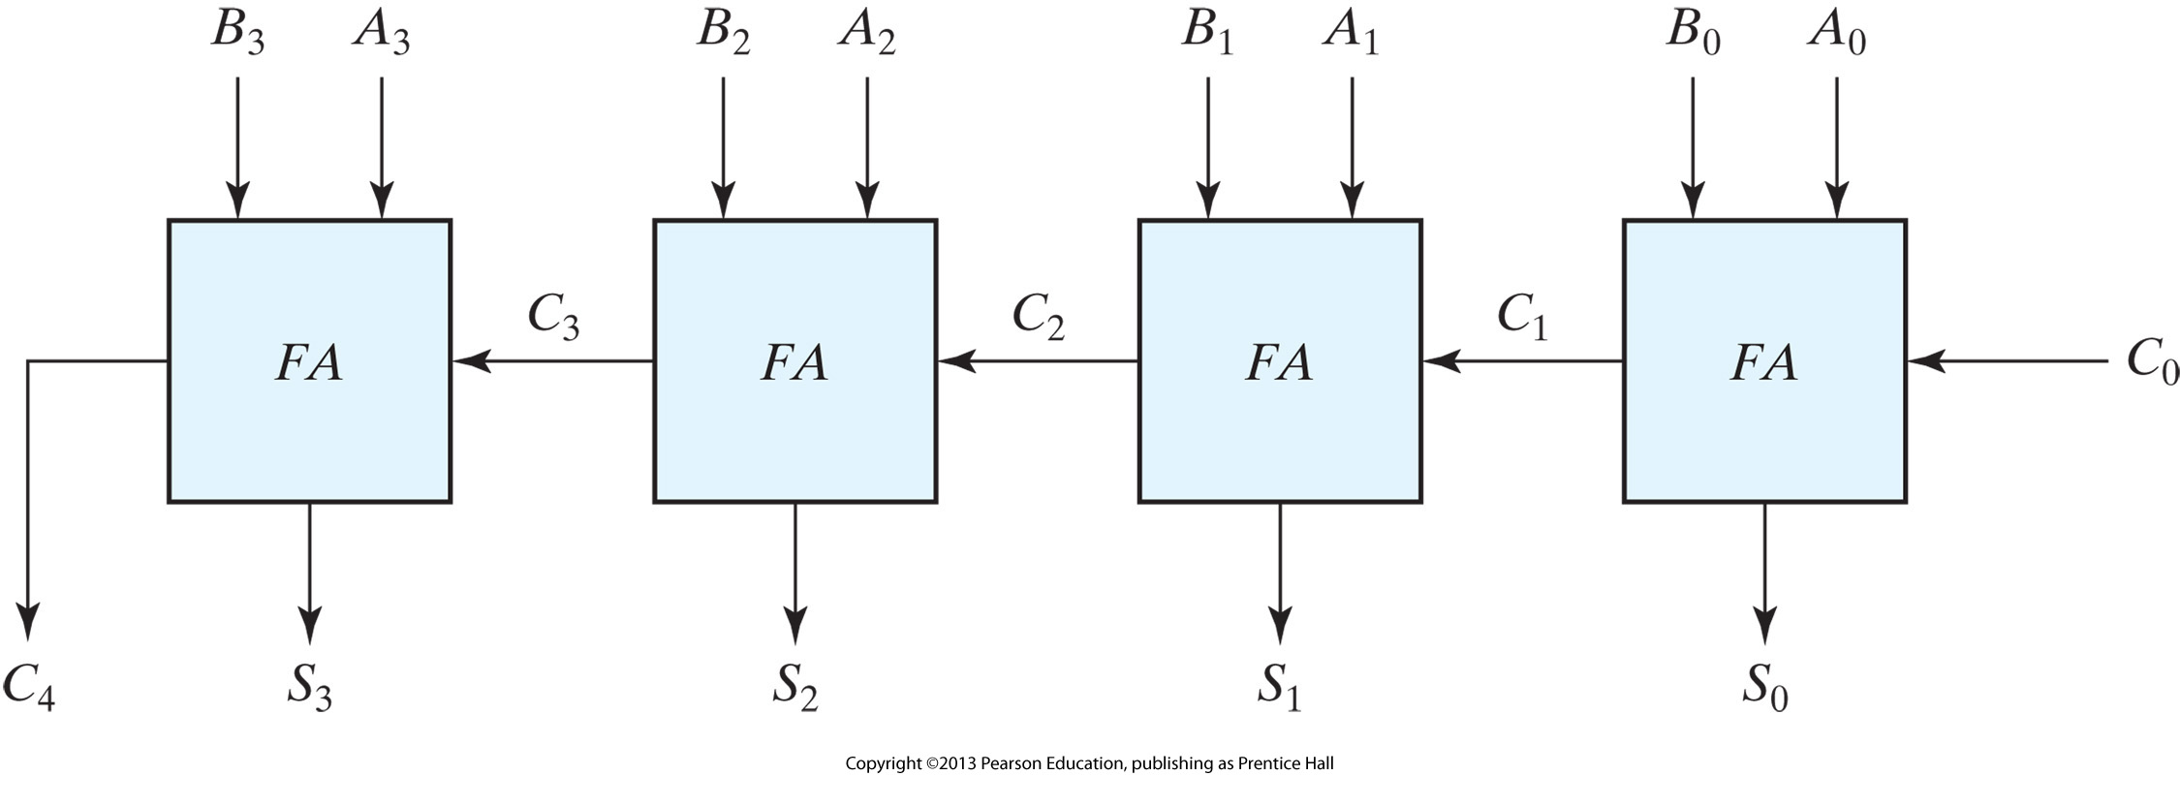
Binary addition of two 4-bit numbers
One way to implement is to use four full-adders:
How many inputs does this circuit have?
How many rows in the truth table?
How fast does this circuit work?
Read carry-look-ahead (CLA) logic in your book on page 155.
Notes:
CLA: more complicated circuit but all carries are computed at the same time (in parallel)

Slide 11
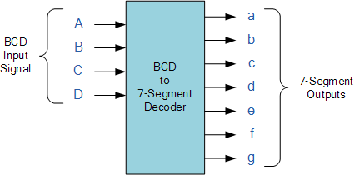
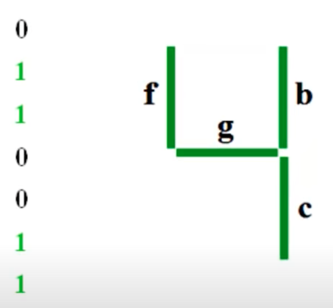
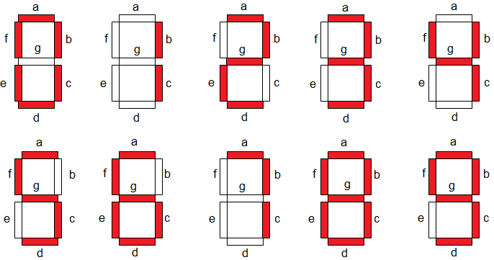
Remember 7-segment display

Slide 12
Design it with a Decoder
a=∑m(0,2,3,5,6,7,8,9)
b=∑m(0,1,2,3,4,7,8,9)
c=∑m(0,1,3,4,5,6,7,8,9)
d=∑m(0,2,3,5,6,8,9)
e=∑m(0,2,6,8)
f=∑m(0,4,5,6,8,9)
g=∑m(2,3,4,5,6,8,9)

Slide 13
4-16 DEC
a=∑m(0,2,3,5,6,7,8,9)
b=∑m(0,1,2,3,4,7,8,9)
c=∑m(0,1,3,4,5,6,7,8,9)
d=∑m(0,2,3,5,6,8,9)
e=∑m(0,2,6,8)
f=∑m(0,4,5,6,8,9)
g=∑m(2,3,4,5,6,8,9)
e
Vcc
D
C
B
A
a = Q₀ + Q₂ + Q₃ + Q₅ + Q₆ + Q₇ + Q₈ + Q₉

Slide 14
Design it with an Active Low Decoder
a=∑m(0,2,3,5,6,7,8,9) =ΠM(1,4,10,11,12,13,14,15)
b=∑m(0,1,2,3,4,7,8,9) =ΠM(5,6,10,11,12,13,14,15)
c=∑m(0,1,3,4,5,6,7,8,9) =ΠM(2,10,11,12,13,14,15)
d=∑m(0,2,3,5,6,8,9) =ΠM(1,4,7,10,11,12,13,14,15)
e=∑m(0,2,6,8) =ΠM(1,3,4,5,7,9,10,11,12,13,14,15)
f=∑m(0,4,5,6,8,9) =ΠM(1,2,3,7,10,11,12,13,14,15)
g=∑m(2,3,4,5,6,8,9) =ΠM(0,1,7,10,11,12,13,14,15)
GND
b = Q₅’ Q₆’ Q₁₀’ Q₁₁’ Q₁₂’ Q₁₃’ Q₁₄’ Q₁₅’
D
C
B
A

Slide 15
Design it with 16-1 MUX
a=∑m(0,2,3,5,6,7,8,9)
b=∑m(0,1,2,3,4,7,8,9)
c=∑m(0,1,3,4,5,6,7,8,9)
d=∑m(0,2,3,5,6,8,9)
e=∑m(0,2,6,8)
f=∑m(0,4,5,6,8,9)
g=∑m(2,3,4,5,6,8,9)
VCC
1
1
0
1
1
1
1
1
1
1
0
0
0
0
0
0
c
A B C D

Slide 16
Design it with 8-1 MUX
f
D’
0
GND
1
D’
D’
0
1
D’
1
0
0
0
1
f
0
0
0
0
A B C

Slide 17
Design it with 4-1 MUX
g
C
C
0
1
D
D’+C’
0
1
1
1
1
0
C’
GND
0
C
D’+C’
C’
0
0
g
A B

